Slide 1

E-Commerce Sales Analysis
E-Commerce Sales Analysis: A Data-Driven Approach
Presented By: Vishakha Chaudhary | Parnika Gaura | Navya Gupta | Kanishk

Slide 2
Introduction & OBJECTIVE
What is E-commerce Sales Analysis?
E-commerce sales analysis is the process of examining and interpreting online sales data to gain insights into business performance, customer behavior, and profitability.
Objective
Monthly Sales Trends: Identify the highest and lowest sales months.
Sales by Product Category & Sub-Category: Determine best and worst-performing product types.
Profit Analysis: Find the most and least profitable months.
Customer Segmentation: Understand how different customer groups contribute to sales.
Sales-to-Profit Ratio: Measure how efficiently sales convert into profit.

Slide 3
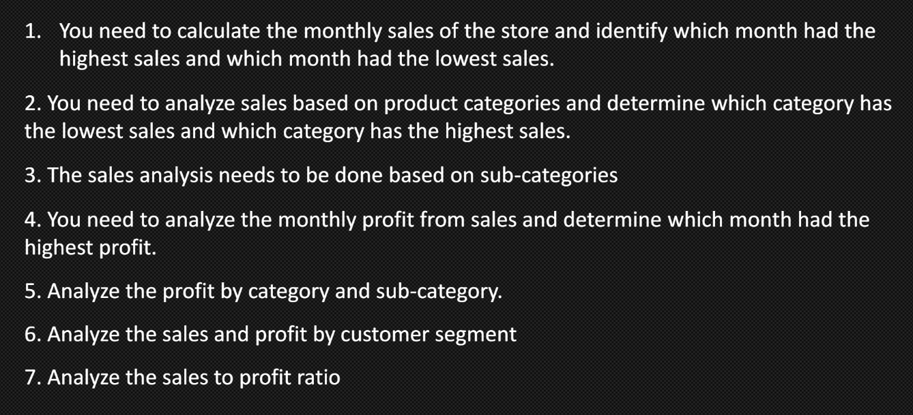
Key Tasks

Slide 4
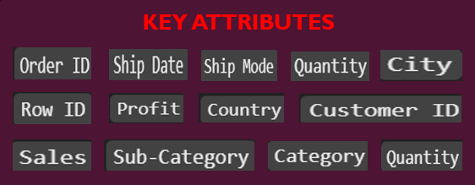





Dataset & Technologies Used
Source: Dataset taken from Kaggle.com
TECHNOLOGIES

Slide 5



Sales & Profit Analysis
Monthly Sales Trends
Profit Trends
Category & Sub-Category Performance
VISUALIZATION
Bar Chart
(Category-wise Sales)
Line Chart (Monthly Trends)
Pie Chart

Slide 6

Sales-to-Profit Ratio & Key Insights
Sales-to-Profit Ratio:
Major Findings from Analysis
Which months/categories perform best/worst?
Which customer segments are most profitable?

Slide 7
Conclusion & Future Scope
By analyzing monthly sales, product categories, and segments, businesses can identify which products sell best and which need improvement.
Future Scope
Use Machine Learning to predict future sales and trends.
AI-based recommendations to improve marketing and product selection.

